Slide 1

CAPSTONE PROJECT
Secure Data Hiding In Images Using Steganography
Presented By: Shubham Balasaheb Deshmukh
Student Name: Shubham Balasaheb Deshmukh
College Name: MET Institute of Engineering, Nashik
Department : Information Technology

Slide 2
OUTLINE
Problem Statement
Technology used
Wow factor
End users
Result
Conclusion
Git-hub Link
Future scope

Slide 3
Problem Statement
Traditional encryption methods, such as cryptographic algorithms, often produce ciphertext that is easily identifiable as encrypted data. This can raise suspicion and may lead to unwanted attention, especially in environments where secure communication is critical.
There is a growing need for a more discreet and effective method to hide confidential messages within everyday digital media, such as images, without altering their perceptible quality. Steganography, the technique of embedding hidden data within an image, offers a solution by ensuring that the presence of the encrypted message remains undetectable.

Slide 4
Technology used
Programming Language: Python
Image Processing Library: OpenCV
Graphical User Interface (GUI): Tkinter
File Handling & Security: Basic encryption logic for password protection
Additional Libraries: Pillow (for image handling)
Platform: Windows 11

Slide 5
Wow factors
Invisible Encryption: Hides secret messages within images without noticeable changes, making detection difficult.
User-Friendly GUI: Simple and intuitive Tkinter interface for encryption and decryption, making it accessible to non-technical users.
Password-Protected Decryption: Ensures only authorized users can retrieve the hidden message, enhancing security.
Lossless Image Steganography: Uses PNG format to prevent data loss and maintain image integrity.
Cross-Platform Compatibility: While optimized for Windows 11, the solution can be adapted for other operating systems.
Real-Time Preview & File Handling: Allows users to select and preview images before encryption and decryption.
Efficient Pixel-Level Encoding: Embeds messages into specific pixel channels, making extraction precise and reliable.

Slide 6
End users
Government & Intelligence Agencies – Securely transmit classified information without raising suspicion.
Journalists & Whistleblowers – Protect sensitive information from censorship and surveillance.
Corporate Sector & Businesses – Safeguard confidential business communications and intellectual property.
Military & Defense Organizations – Hide strategic messages in images for covert communication.
Cybersecurity Experts & Ethical Hackers – Explore advanced steganographic techniques for secure data transfer.
Researchers & Academicians – Study data hiding techniques for digital forensics and cryptography.
General Users & Privacy Enthusiasts – Protect personal messages from unauthorized access.

Slide 7
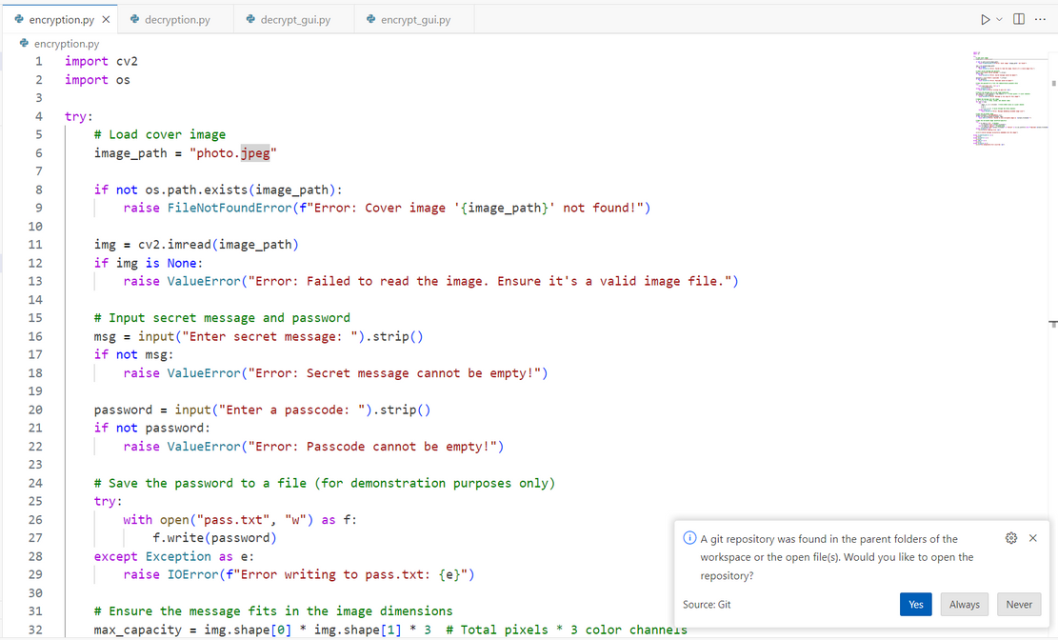
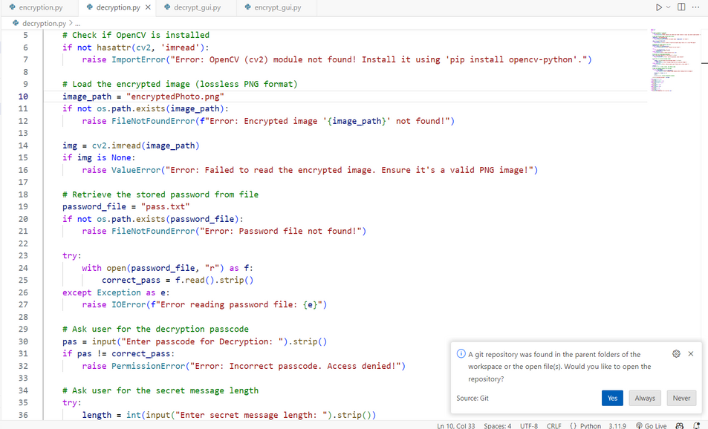
Results
Encryption.py
Decryption.py

Slide 8
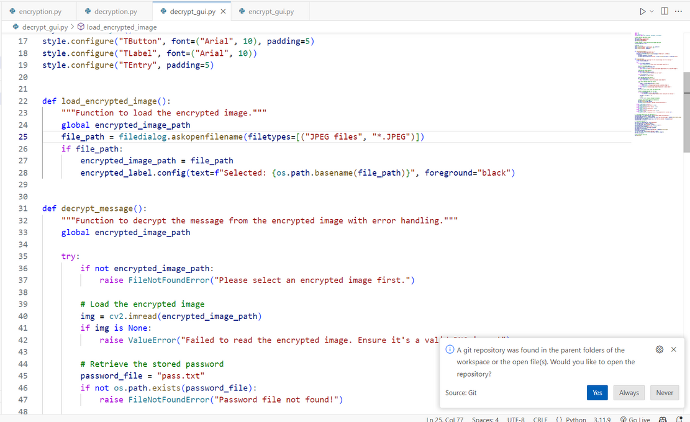
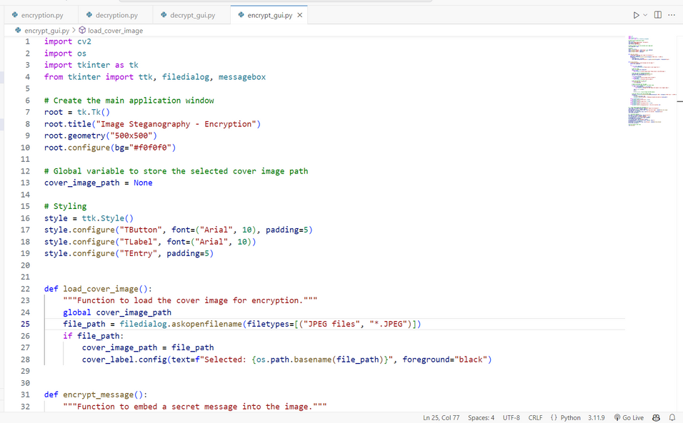
Results
Encryption_gui.py
Decryption_gui.py

Slide 9
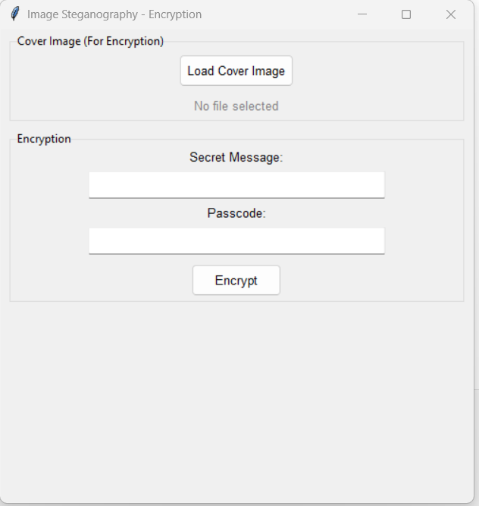
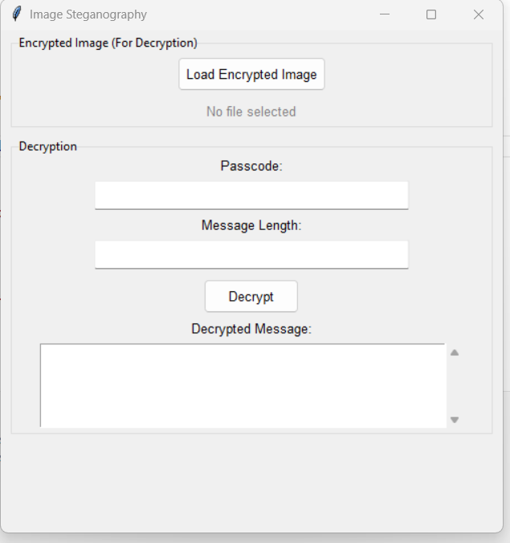
Results
Encryption_gui
Decryption_gui

Slide 10


Results
Photo.jpeg
Encryptedphoto.jpeg

Slide 11
Conclusion
In an era where data security and privacy are of utmost importance, image steganography provides an innovative and discreet way to safeguard confidential information. By embedding messages within images without altering their visual integrity, this technology ensures secure communication while minimizing the risk of detection. The integration of OpenCV for image processing, Tkinter for a user-friendly interface, and encryption techniques for password protection makes this solution accessible even to non-technical users. Whether for government agencies, businesses, journalists, or cybersecurity professionals, this approach offers a seamless and effective method for secure data transmission.

Slide 12
GitHub Link
https://github.com/ShubhamDeshmuk-h/Stegno_project

Slide 13
Future scope
Enhanced Security with Advanced Encryption – Integrating AES or RSA encryption along with steganography can provide an extra layer of security, making hidden data even more resistant to attacks.
AI-Powered Steganalysis Detection – Machine learning algorithms can be implemented to analyze and detect steganographic patterns, helping in both improving security and countering unauthorized use.
Support for Multiple File Types – Future iterations can enable embedding not just text but also files like PDFs, audio, or even small executable scripts within images for enhanced data hiding.
Cloud-Based Secure Messaging – The technology can be integrated into cloud platforms, allowing users to send and retrieve steganographic messages securely over the internet.
Blockchain for Tamper-Proof Security – Leveraging blockchain to track and verify steganographic data transactions can ensure authenticity and prevent unauthorized modifications.

Slide 14
THANK YOU

